Slide 1
Comparison of Cytotoxic, Genotoxic And Apoptotic Effects of Broccoli (Brassica Oleracea var. Italica) And Cauliflower (Brassica Oleracea var. Botrytis) Extracts on Colon Cancer Cells
Merve Sena YAKUT
Mentor: Abdürrahim KOÇYİĞİT
Yardımcı Araştırmacı: Ebru KANIMDAN

Slide 2
INTRODUCTION
It is known that many compounds with antioxidant properties can also show pro-oxidant activity at high doses.
Many studies have been conducted showing that polyphenolic compounds, which are known to be antioxidants, can be used as a chemotherapeutic agent in cancer treatment because they show pro-oxidant activity with increasing dose.
Sulfaropane, an organic sulfur compound, is an important substance found in broccoli and cauliflower with anti-cancer activity.

Slide 3
INTRODUCTION
In cell culture studies conducted in recent years, it has been reported that broccoli and cauliflower extracts have a pro-oxidant effect by causing an increase in reactive oxygen radicals (ROS) in some cancer cells and normal cells, and have antiproliferative and apoptotic effects, especially on cancer cells.
However, the comparison of cytotoxic, genotoxic and apoptotic effects of these two plants on cancerous and normal cells could not be found together in the same study.
Our aim with the project is to investigate the relationship of broccoli and cauliflower extracts with cytotoxic, genotoxic and apoptotic effects and intracellular ROS production levels on in vitro colon cancer (HT-29) and normal cell lines (CCD-18Co).

Slide 4
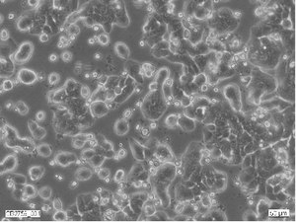
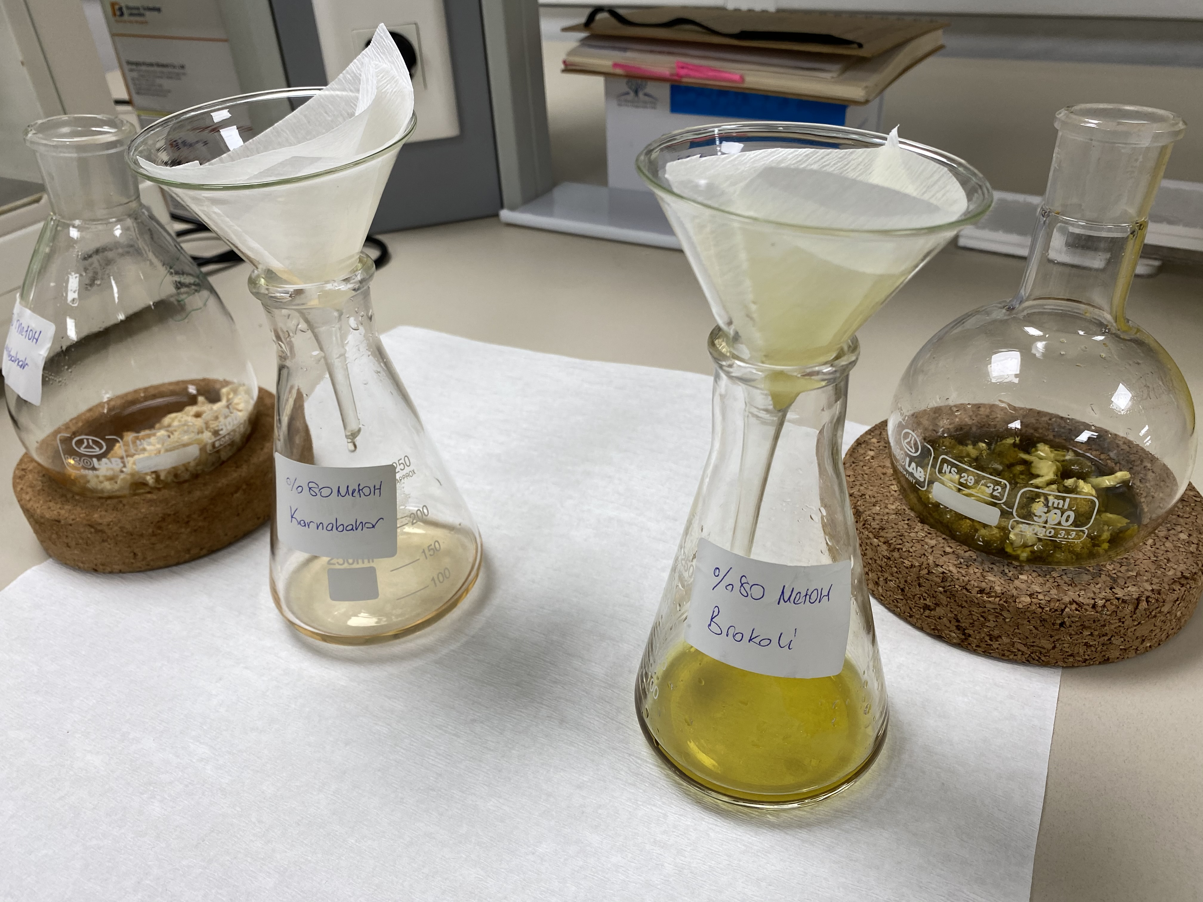
MATERIALS AND METHODS
Cell culture
Colon cancer (HT-29) and normal cell lines (CCD-18Co) were used in our project. Cells were cultured in culture media suitable for them. containing 10% FBS and 1% penicillin / streptomycin (100 U / ml penicillin and 100 μg / ml streptomycin). Cultures were carried out in sterile laminar air flow cabinets. Incubation of cells was carried out in a 5% CO2 and 37 ° C oven. Excess cells were stocked in freezing medium, containing 10% DMSO in a nitrogen tank.
Plant extraction
Broccoli and cauliflower vegetable sprouts were cut into small pieces with a blender. The separated pieces were mixed with 70% alcohol at a ratio of 2/1 (p / v) and incubated at room temperature in an orbital shaker for 24 hours at 400 rpm. After the incubation, it was filtered through Whatman paper, after the alcohol was evaporated at 45oC in a rotary evaporator, it was lyophilized in a lyophilizer. After the lyophilized extract was dissolved with DMSO, cytotoxicity analysis was performed at different concentrations in cell culture medium.

Slide 5
MATERIALS AND METHODS
Determination of Total Antioxidant Capacity
Brokoli ve karnabahar ekstrelerinin içeriğindeki antosiyanin miktarının belirlenmesi için %1’lik HCL-metanol/etanol (w/v) çözeltisi içerisinde seyreltilen örnekler, 60oC’lik su banyosunda 1 saat boyunca çalkalanarak inkübe edildikten sonra, Whatman filtre kağıdı ile süzülüp elde kalan çözeltinin 657 ve 530 nm’lerde spektrofotometrik ölçümü alındı.
Determination Of Total Phenolic Content
The Folin-Ciocalteu method was used to determine total phenolic content of he broccoli and cauliflower samples.
Determination Of Total Flavonoid Content
The amount of total flavonoid compound was calculated from the absorbance values ​​read at 420 nm and the quercetin curve used as a standard at the end of 1 hour incubation of the samples treated with aluminum chloride.

Slide 6
MATERIALS AND METHODS
Cell Viability Assay (Cytotoxicity)
Cell Titer-Glo Luminescent Cell Viability Test Kit (Promega) was used to measure cell viability level. This method determines the degree of cell viability in proportion to the amount of ATP.
For analysis, colon cancer and normal cell lines (1.5 × 103 cells well−1) were plated on 96-well plates. After 24 hours, the cells were incubated with different concentrations (100 to 900 ug/mL).After 24-hour incubation, ATP solution was added and the luminescence was measured in luminometry within 10 minutes. Results were calculated by normalizing with the control cells (cells with 0.1% DMSO added) IC50 values of the items were tried to be found.
Genotoxicity Assay
Genotoxic activity was evaluated by alkaline single cell electrophoresis (comet assay) method.
Evaluation of Apoptotic Activity
Apoptosis induction was detected by flow cytometric and acridine orange (AO/EB) straining methods.

Slide 7
RESULTS – Total Antioxidant Capacity
Table 1. Total Antioxidant Capacity (TAC) results
Cauliflower and broccoli extracts has increased TAC in a dose depended manner. At the same concentrations, broccoli had higher TAC than cauliflower.

Slide 8
RESULTS – Total Phenolic & Flavonoid Content
Table 2. Total Phenolic Content results
Table 3. Total Flavonoid Content results
It was determined that broccoli and cauliflower showed really close activity to each other for the total phenolic content, broccoli showed higher activity for the total flavonoid content.

Slide 9
RESULTS – Cytotoxicity (MTT Assay)
The IC50 value of broccoli extract was found to be approximately 8.9 mg/ml for HT-29 cells, while this value was determined as approximately 11 mg/ml for CCD cells. After 48 hours, the cell viability of broccoli and cauliflower extracts was approximately 57% and 71% for colon cancer cells, respectively.

Slide 10
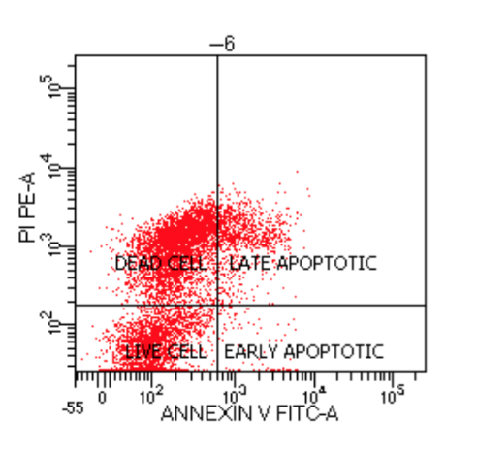
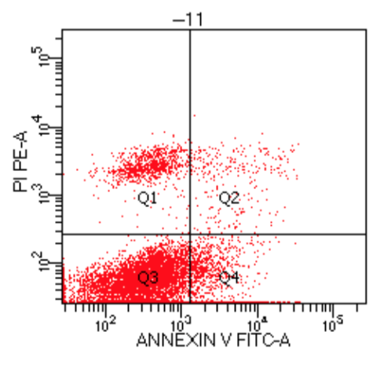
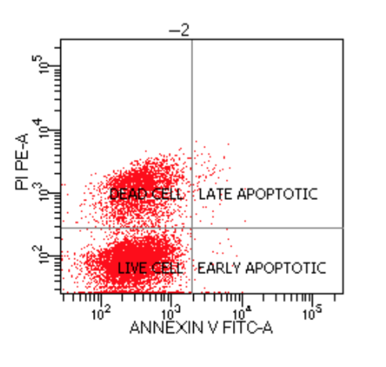
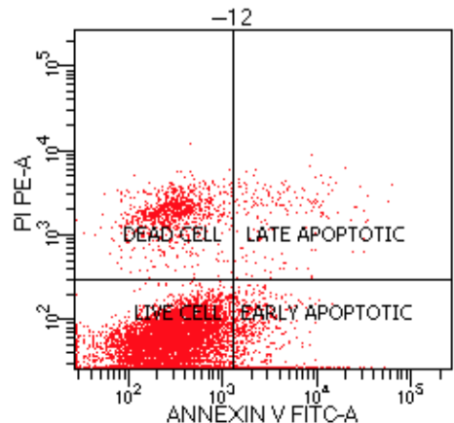
RESULTS - Apoptosis
Control HT-29 cell line
7,5 mg broccoli HT-29 cell line
7,5 mg cauliflower HT-29 cell line
Control CCD cell line
7,5 mg broccoli CCD cell line
7,5 mg cauliflower CCD cell line

Slide 11
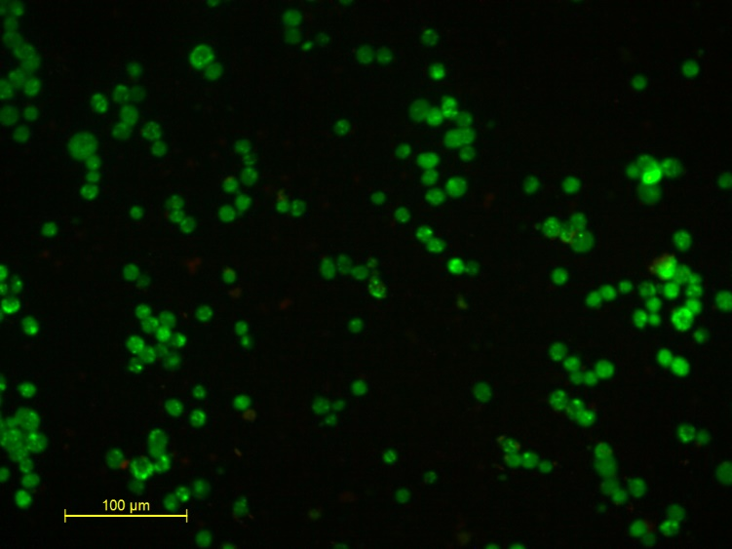
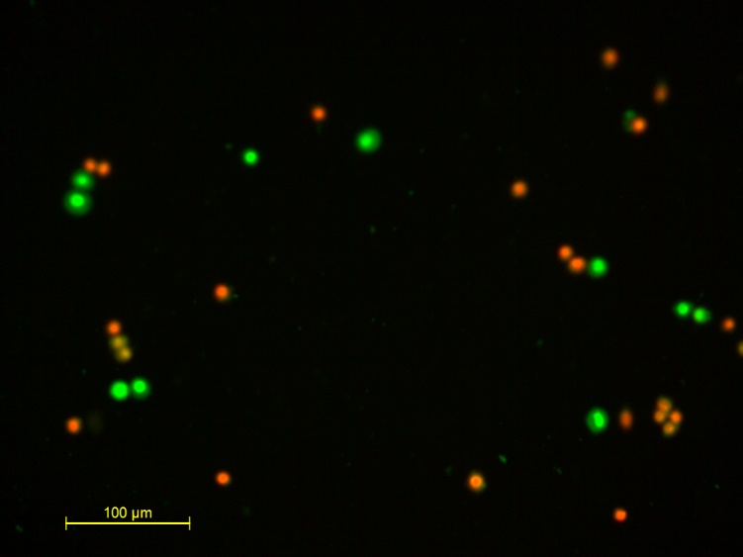
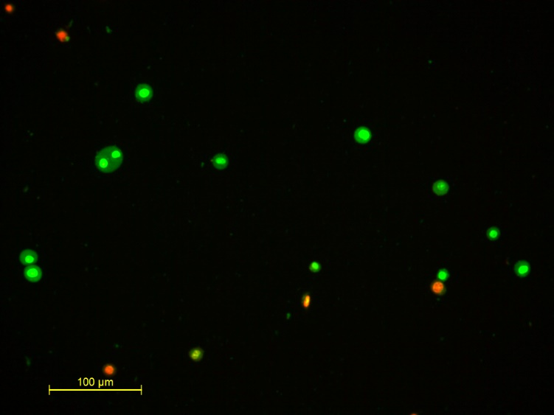
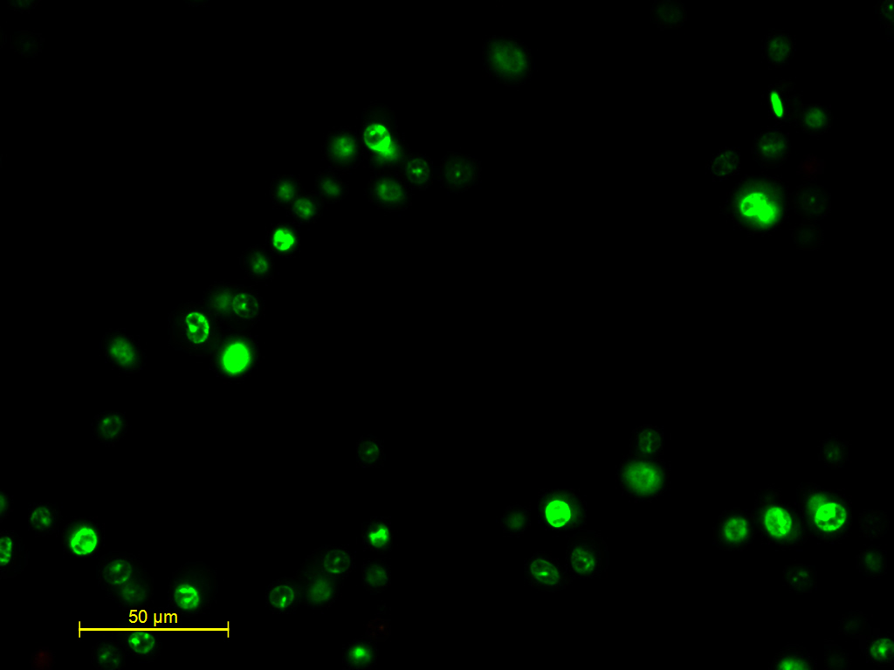
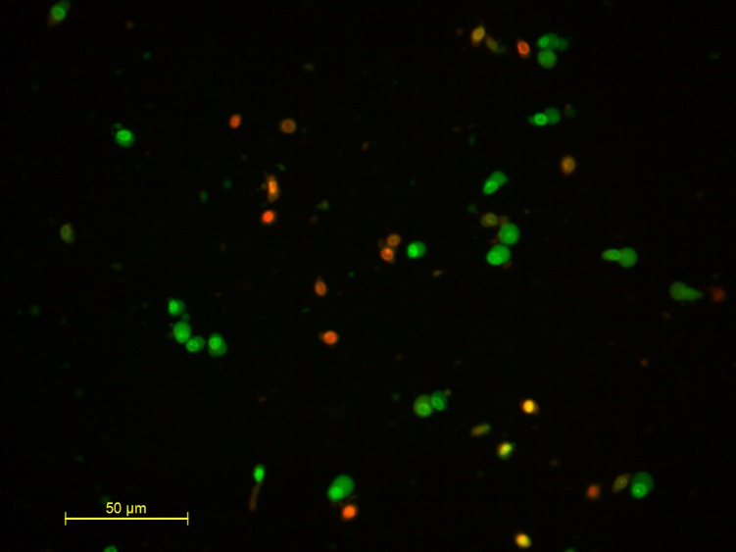
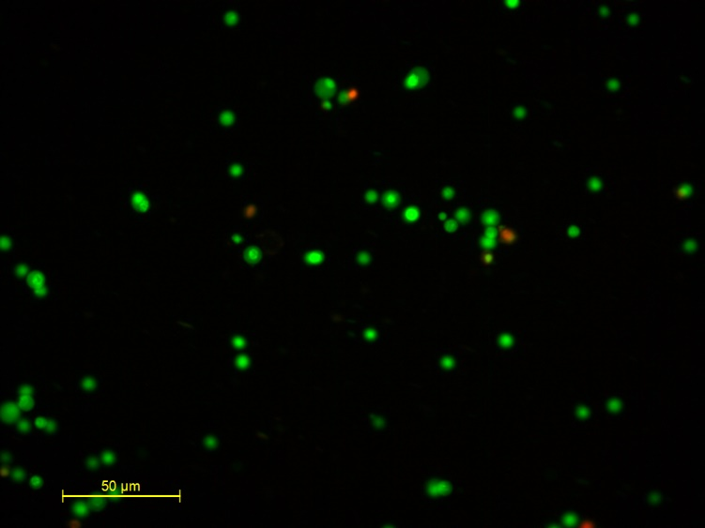
RESULTS - Acridine Orange Ethidium Bromide Staining
Control HT-29 cell line
7,5 mg broccoli HT-29 cell line
7,5 mg cauliflower HT-29 cell line
Control CCD cell line
7,5 mg broccoli CCD cell line
7,5 mg cauliflower CCD cell line

Slide 12
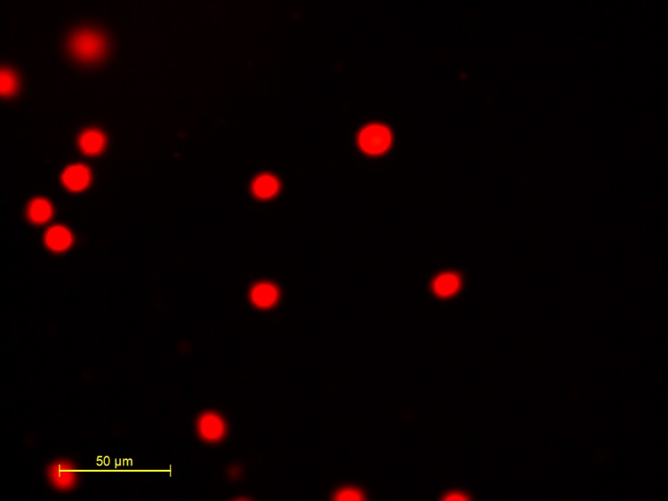
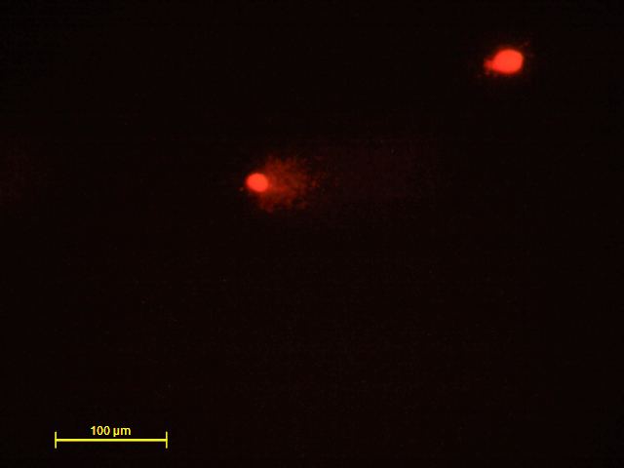
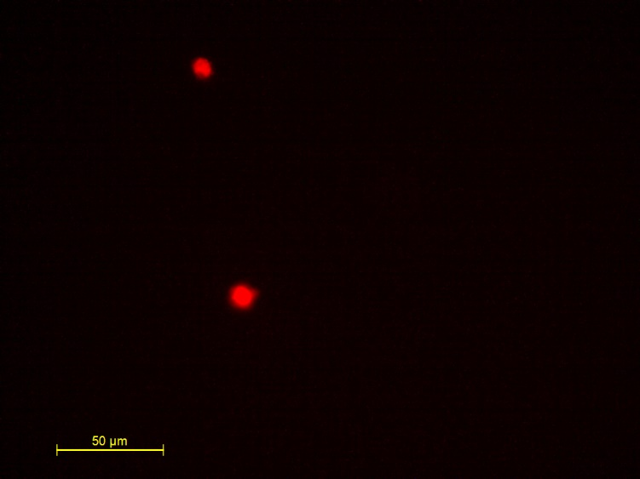
RESULTS – Genotoxicity (Commet Assay)
Control HT-29 cell line
7,5 mg broccoli HT-29 cell line
7,5 mg cauliflower HT-29 cell line

Slide 13
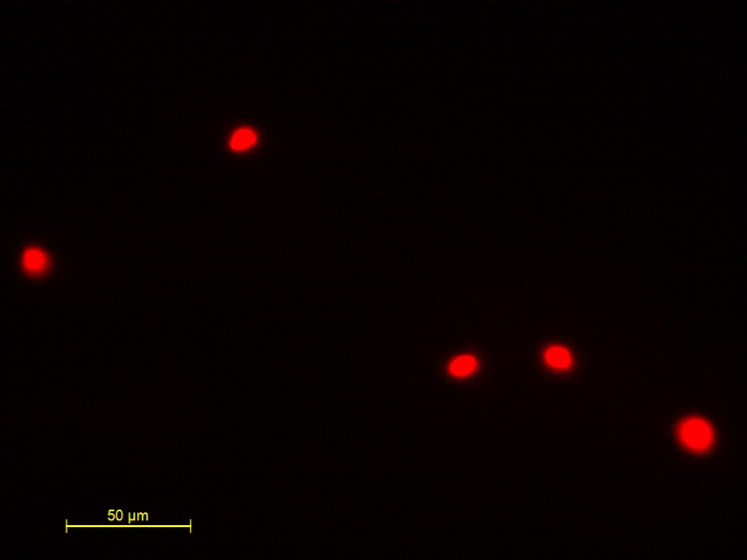
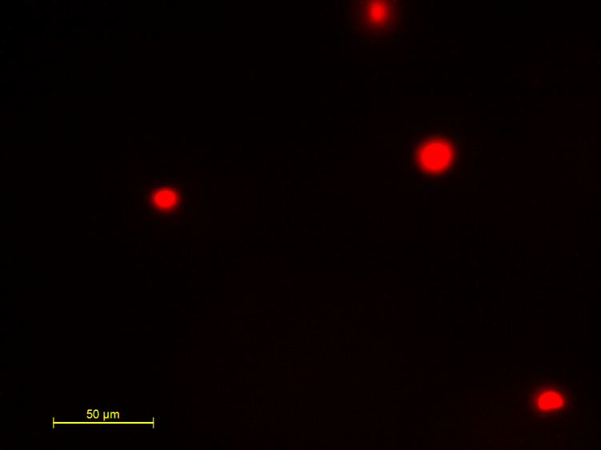
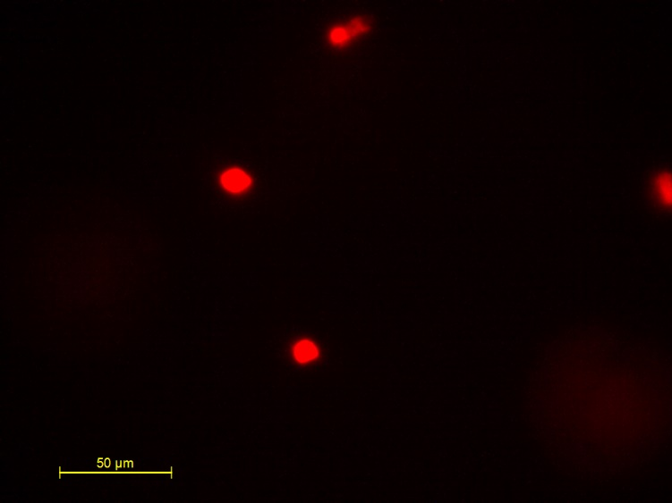
RESULTS - Genotoxicity (Commet Assay)
Control CCD cell line
7,5 mg broccoli CCD cell line
7,5 mg cauliflower CCD cell line

Slide 14
CONCLUSION
At the same concentrations, broccoli had higher TAC than cauliflower.
It was determined that broccoli and cauliflower showed really close activity to each other for the total phenolic content, broccoli showed higher activity for the total flavonoid content.
Flow cytometry and AO/EB results showed that broccoli has more apoptotic effects than cauliflower.
As a result of the cytotoxicity experiment, the IC50 value in cancer cells treated with broccoli extract was reached after 48 hours of incubation. IC50 was found to be 8.9227919mg/ml.
In cauliflower extract, IC50 value could not be reached in normal (CCD) and colon cancer (HT-29) cells at 24 and 48 hours exposure at the same concentrations.
As a result of our study, it was determined that broccoli extracts had more lethal effect on colon cancer cells than cauliflower. When comparing normal cells and colon cancer cells, it was also shown that cell viability was higher in normal cells at the same concentrations.

Slide 15
CONCLUSION
According to the results of our study, it was determined that broccoli and cauliflower plants, which are known to be powerful antioxidants, have cytotoxic, genotoxic and apoptotic effects on cancer cells.
This project should be supported by in vivo studies to investigate whether broccoli and cauliflower can be used as complementary therapy in addition to chemotherapy on cancer patients.
It might be stated our project does not defend a high intake of broccoli and cauliflower can totally protect from tumors or cure cancer.

Slide 16
REFERENCES
M.K. Kim, J.H. Park, Conference on “Multidisciplinary approaches to nutritional problems”. Symposium on “Nutrition and health”. Cruciferous vegetable intake and the risk of human cancer: epidemiological evidence Proc Nutr Soc, 68 (2009), pp. 103-110
M.M. Gaudet, J.A. Britton, G.C. Kabat, et al. Fruits, vegetables, and micronutrients in relation to breast cancer modified by menopause and hormone receptor status. Cancer Epidemiol Biomarkers Prev, 13(2004), pp. 1485-1494
T.K. Lam, L. Gallicchio, K. Lindsley, et al.Cruciferous vegetable consumption and lung cancer risk: a systematic review. Cancer Epidemiol Biomarkers Prev, 18(2009), pp. 184-195
G. Yang, Y.T. Gao, X.O. Shu, et al.Isothiocyanate exposure, glutathione S-transferase polymorphisms, and colorectal cancer risk. Am J Clin Nutr, 91 (2010), pp. 704-711
L. Tang, G.R. Zirpoli, V. Jayaprakash, et al.Cruciferous vegetable intake is inversely associated with lung cancer risk among smokers: a case-control study. BMC Cancer, 10 (2010), p. 162
S. Barcelo, J.M. Gardiner, A. Gescher, J.K. Chipman, CYP2E1-mediated mechanism of anti-genotoxicity of the broccoli constituent sulforaphane, Carcinogenesis 17 (1996) 277–282.
L. Gamet-Payrastre, Signaling pathways and intracellular targets of sulforaphane mediating cell cycle arrest and apoptosis, Curr. Cancer Drug Targets 6 (2006) 135–145.
J.D. Clarke, R.H. Dashwood, E. Ho, Multi-targeted prevention of cancer by sulfo- raphane, Cancer Lett. 269 (2008) 291–304.
Wiczk A¹, Hofman D, Konopa G, Herman-Antosiewicz A. Sulforaphane, a cruciferous vegetable-derived isothiocyanate, inhibits protein synthesis in human prostate cancer cells. Biochim Biophys Acta. 2012 Aug;1823(8):1295-305.

Slide 17
THANK YOU FOR LISTENING Questions?

